Slide 1
The South African Colonial Town
The Largest group of European settler towns in the continent were located in southern Africa. They were mostly planned towns comparable to colonial towns founded in other-mid latitude settlements created during the same time period.
Cape Town, South Africa will be used to demonstrate the complex evolution of colonialism, segregation, and apartheid on the African City.
The fort and garden at Cape Town were established in 1652. In 1657 the first free settlers were allowed to establish their own houses outside of the fort. It was established as a restocking point for Dutch ships
Plan of Cape Town: grid pattern of small blocks at right angles to the sea and narrow cross-streets. Trees were planted along the main streets to give the settlement an enclosed urban feel.
The town’s construction was strictly regulated and high density construction was encouraged. To reduce the risk of a catastrophic fire, thatch and timber were banned at the beginning. This led to plaster being used to protect walls; therefore, the whitewashed flat roofed Cape variant was common in Cape Town and other southern African towns until 1850.

Slide 2
Early Cape Town
The administrative, military, commercial, and ecclesiastical capital of southern Africa.
The Town remained comparatively small for 200 years.
→At the end of the Dutch period in 1806, the population was only 16,400 (6,400 Europeans)
→ Cape Town was only 100 ha is size until 1800 because of the control over urban development.

Slide 3
Based on Trade
The Town exhibited functional zoning
Trade was the primary reason why the town was founded; therefore, there were a series of warehouses, stores, and hotels built nearby the beach and pier (a harbor was not constructed until the 1860s).
Governance was also important to the town. This function was carried out in the castle until the fortification became too cramped.

Slide 4
Urban sprawl and the development of infrastructure
Industry and trade expansion led to a rapid increase in population.
→1904-179,000 (107,000 were Europeans)
The construction of docks and the railway greatly changed the city in 1860.
The docks and related facilities (including sheds for cold storage and coal facilities) would allow Cape Town to remain a major port on the trade routes of the world.
The railway provided cheaper transportation to and from the docks.
In the city, trams and a suburban railway line helped create residential sprawl.

Slide 5
Development of a central business district
By 1910, Cape Town was a modern city.
The core was no longer residential as a number of business streets replaced trees and gardens.
Major banks attempted to create prestigious buildings
The offices and shops now reflected British Imperial architecture rather than the earlier Cape-Dutch style.

Slide 6
Residential trends
The constraints of the earlier town planning were broken as construction of a mixed landscape of houses, shops, schools, churches, and factories began to dominate the townscape after 1900.
Higher elevations (upper mountain slopes) possessed large plots and contained vistas and exotic houses.
Lower elevations (Cape Flats) exhibited single-story terraces.
Racial segregation became apparent as non-European groups had very low socio-economic status.
Non-European groups were concentrated in the poorer parts of town. Especially near the industrial areas.
Legislative segregation was not enforced until the 1890s; however, the first separate location for Africans, Ndabeni, was created in 1901 on the Cape Flats, 8 km from the center of the city.

Slide 7
The creation of towns in South Africa
South Africa, unlike North Africa, did not possess many pre-colonial towns.
European powers were able to select the site where a new town was to be established.
Over 600 towns were established in South Africa during the colonial period.
These towns were established for administrative, commercial, ecclesiastical and industrial purposes.
The towns included permanent settlers that carried out the above mentioned purposes over a significant indigenous population.

Slide 8
The ad hoc foundation of towns
A new town was established when it was perceived that a new town was needed.
→the state, church, or private individual attempted to layout a town.
→Most towns were established as a result of the European colonization of new areas and the development of the economy and the growth of population within existing areas.
→Little regulation over the establishment of new towns existed.
→This led to creation of excessive town foundation and the competition between towns.
Competition among towns led to the simplification of the urban hierarchy
→some towns shrank after initial period of growth as their key functions were taken over by another town.
→For instance, Weenen was replaced by Estcourt except for basic services. Harrismith was physically moved to another location because the original location of the town was not sufficient.

Slide 9
The early South African town
The majority of towns were established to serve rural communities, this was before the integration of an industrial economy in southern Africa.
Towns offered substantial plots to allow for the cultivation of crops and the grazing of livestock.
These towns had to be self-sufficient prior to the transport revolution in the late 19th and early 20th centuries.

Slide 10
The layout of the typical South African Town
Rigid gridiron pattern with streets intersecting at right angles.
Towns plans revolved around a major structure (church, prison, etc.).
Vistas focuses upon the main building in the town.

Slide 11
Pre-World War 1 South African Town
Towns prior to WW1 were still small.
In 1911, 1.5 million people lived in 362 towns (667,000 white and 494,000 were black
Half the towns had populations under 1,000
Only 9 % of towns exceeded 5,000 inhabitants. Most of these larger towns were the result of the mining industry and port cities.
The next 50 years (1911-1966) the urban population increased fivefold.
The port cities experienced the largest increase in population. This trend follows the Vance Model of mercantilism and created an urban hierarchy in South Africa.
Smaller towns tended to experience population declines or remain stagnant.
→see the module on the colonial capital for a discussion on African primate cities

Slide 12
The African Town in the post-First World War period
Redevelopment of the central business district:
After WW1, Johannesburg took over Cape Town’s role as the financial center of the subcontinent. The city provided an example from which the Central Business District in cities across South Africa developed.
→Main urban centers saw the redevelopment of old structures and vertical expansion, resulting in the construction of high-rise office buildings.
→Redevelopment of the central business district was very selective. Corporations located their offices in only a few cities. This process also help simplify the urban hierarchy.
The Central Business District have two distinct commercial sectors.
→one dealt with European trade
→Another towards African and “Coloured” trade controlled by Indian traders. The Indian population formed a cultural enclave within the European parts of many South African towns.

Slide 13
Urban Sprawl
Rural to Urban migration and the transport revolution led to an expanded African town.
→As mentioned in the discussion of Cape Town, light rail allowed affluent Europeans to move to distant suburbs.
→farmland along the outskirts of cities became housing estates.
→Expansion of residential areas due to an increasing European population was accompanied by the increased amount of land needed for manufacturing.
→Between 1911 and 1960, the manufacturing industry increased its production value from 8.9 million pounds to 525.5 million pounds. Manufacturing contributed as much to the Gross Domestic Product of South Africa as agriculture and mining combined.
→The urban population tended to increase greatest where manufacturing was concentrated.

Slide 14
Shanty towns
The urban sprawl led to the establishment of informal settlements constructed out of tin, cardboard and wood.
Government regulation was limited and sporadic.
Located on the outskirts of town
Mostly housed Africans, however, Europeans lived in them temporarily during the depression of the 1930s.
After outbreaks of the bubonic plague in 1904, city governments feared the health hazards of the shantytowns and resorted to removing them and creating isolated state housing units. In some instances, such as in Johannesburg, the housing facilities were located 20km from the center of the city.

Slide 15
The segregated City
Enforced segregation was an attempt to preserve urban resources for only European use. It was also meant to keep the towns European in nature in the face increasing rural-urban migration.
Urban segregation was enforced under the Natives (Urban Areas) Act of 1923 that preserved the town as a European area with no place for the redundant native.
Shantytowns were demolished and African occupied portions of cities destroyed. These areas became dormitories with a uniform design.
100,000 units of low cost housing were constructed near Johannesburg.

Slide 16
Segregation against Indians and Coloured populations
Indian migration to South Africa increased between 1880-1900
They established trading enterprises that began to compete with European trade
Restrictive measures limited their rights to engage in business and live in areas restricted for only whites.
1943→interacial business transactions prevented
1950→Act passed with the intention of removing indians and other coloured people from South African towns

Slide 17
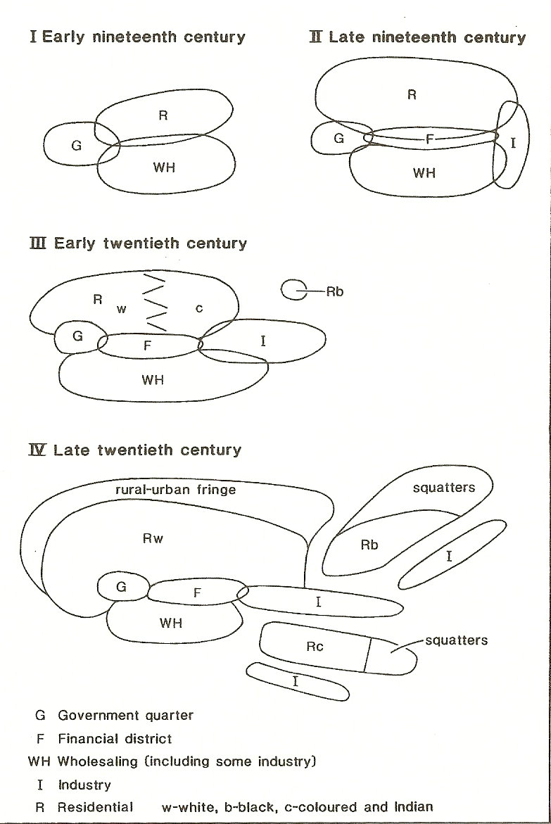
The Evolution of the South African Colonial City

Slide 18
The emergence of the Apartheid City, a variant of the colonial city
The Central Business District was now dominated by Europeans; the Indian presence was largely removed.
Distinct sectors appeared in the city. The largest sectors were held by Europeans; smaller sectors were inhabited by specific racial groups in the city.
Each racial group was separated by a buffer, small strips of land, or strategically positioned industrial locations.
This city was in stark contrast to the colonial city that exhibited concentric rings with an European center, smallholdings, and squatter towns.
Tighter state control over the city allowed the apartheid city to emerge.
Although several colonies had restrictive policies pertaining to land ownership, no other colony tried to convert the colonial city to the Apartheid colony, except in South West Africa.
In contrast, the Central Business District in Nairobi, Kenya was dominated by an Asian population. In 1962, Asians accounted for three-quarters of its population.

Slide 19
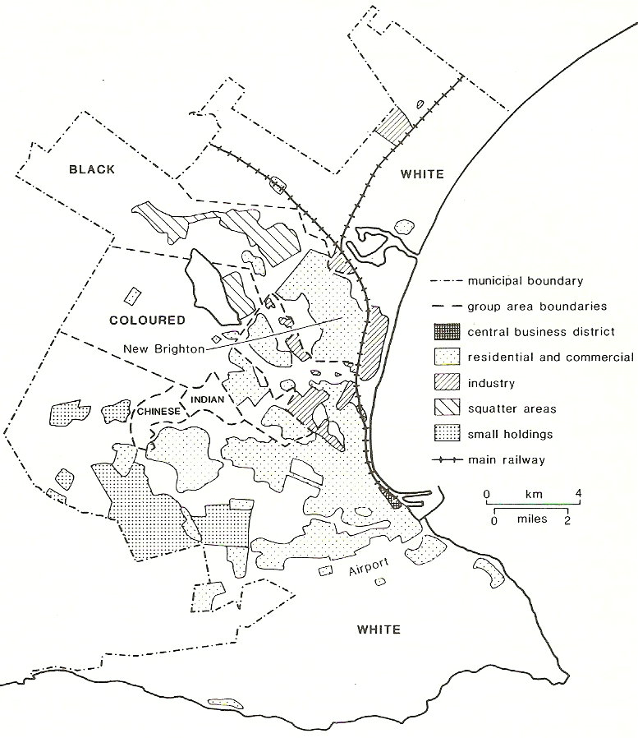
The Apartheid City of South Africa
Note the residential segregation that is apparent in Port Elizabeth, 1960
The Central Business District is also connected to the main railway.

Slide 20
Differences among colonial cities
The extensive layout of the colonial city would never have been possible in Europe
The British and Germans never attempted to create a close urban setting like the Portuguese or French.
The dominance of the government can be observed by the extensive parks, experimental farms, racecourses, police and army camps, gold courses and polo grounds created for colonial officials and their families. These facilities were commonly positioned near the centre of the city.
The positing of these locations is a testament to the priorities of colonial society.

